Slide 1


Movie Recommendation using
Sentimental Analysis
Indian Institute of information Technology Allahabad
Prayagraj (UP) India
Group Members:
Rohan Singhvi (IIB2020004)
Akash Biswas (IIT2020001)
Shubham Bhokta (IIT2020007)
Aashish Agarwal (IIT2020009)
Rahul Mahto (IIT2020022)
Guided by:
DR. Triloki Pant

Slide 2
TABLE OF CONTENTS
01
06
02
07
08
03
04
09
05
10
Introduction
Experimental Setup
Applications
Result
Conclusion
Related Works
Challenges
Future work
Proposed Solution
Demo

Slide 3



INTRODUCTION
In the vast landscape of digital entertainment, the sheer volume of movies available to audiences can be overwhelming. Movie recommendation systems have emerged as invaluable tools to help users navigate this extensive cinematic library and discover films that align with their preferences. Content-based movie recommendation systems operate by extracting relevant information about movies, such as genres, directors, actors, and themes. One of the strengths of content-based recommendation systems is their ability to provide personalized suggestions, even for users with unique or niche preferences. These systems are particularly effective when dealing with the "cold start" problem, where there is limited or no user interaction data available for new users.

Slide 4
APPLICATIONS
Content-based movie recommendation systems find applications in various platforms and industries to enhance user experience and engagement. Some notable applications include:
Streaming Services: | Platforms like Netflix, Hulu, and Amazon Prime Video use content-based recommendation systems to suggest movies to users based on their viewing history, genre preferences, and content features.
E-commerce Platforms: | Online marketplaces that offer or rent movies, such as iTunes or Google Play Movies, utilize content-based recommendation systems to suggest additional films for purchase or rental based on a user's past transactions and preferences.
Educational Platforms: | Platforms providing educational content, such as documentaries or historical films, can use content-based recommendation systems to suggest relevant movies based on a user's academic interests or subjects of study.
Airlines and In-Flight Entertainment: | n-flight entertainment systems can use content-based recommendations to suggest movies to passengers based on their historical preferences, ensuring a more enjoyable travel experience.

Slide 5
03
RELATED WORK

Slide 6
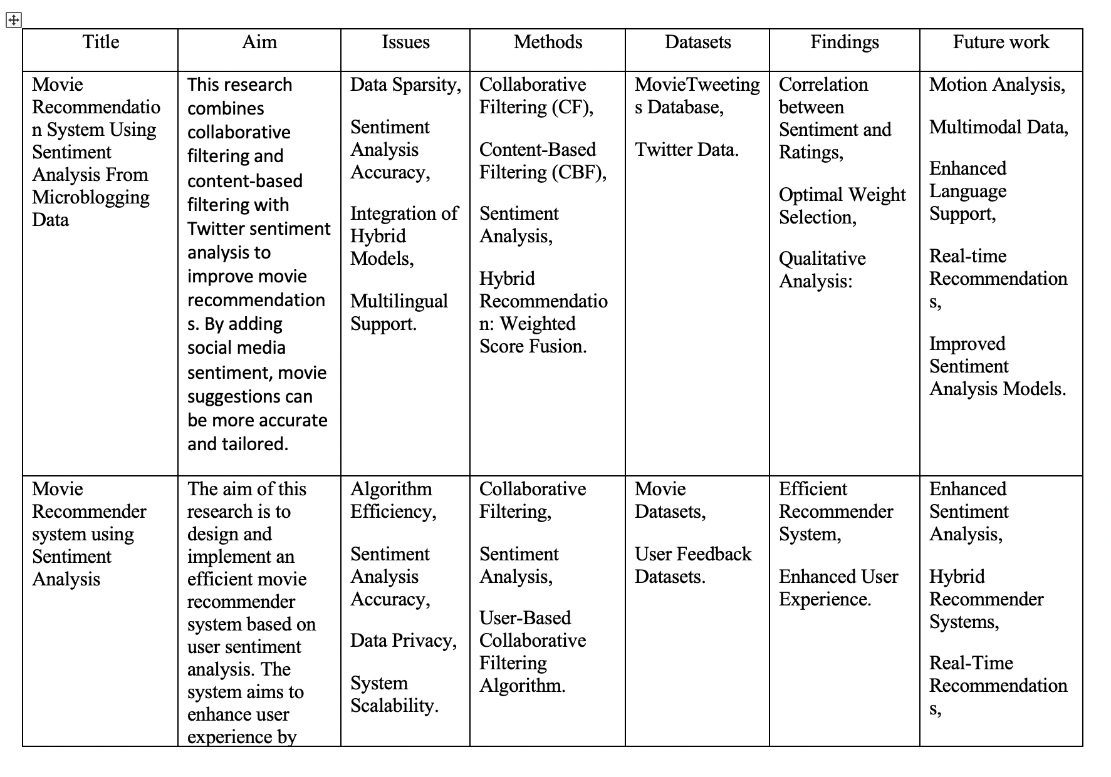
Literature Review

Slide 7
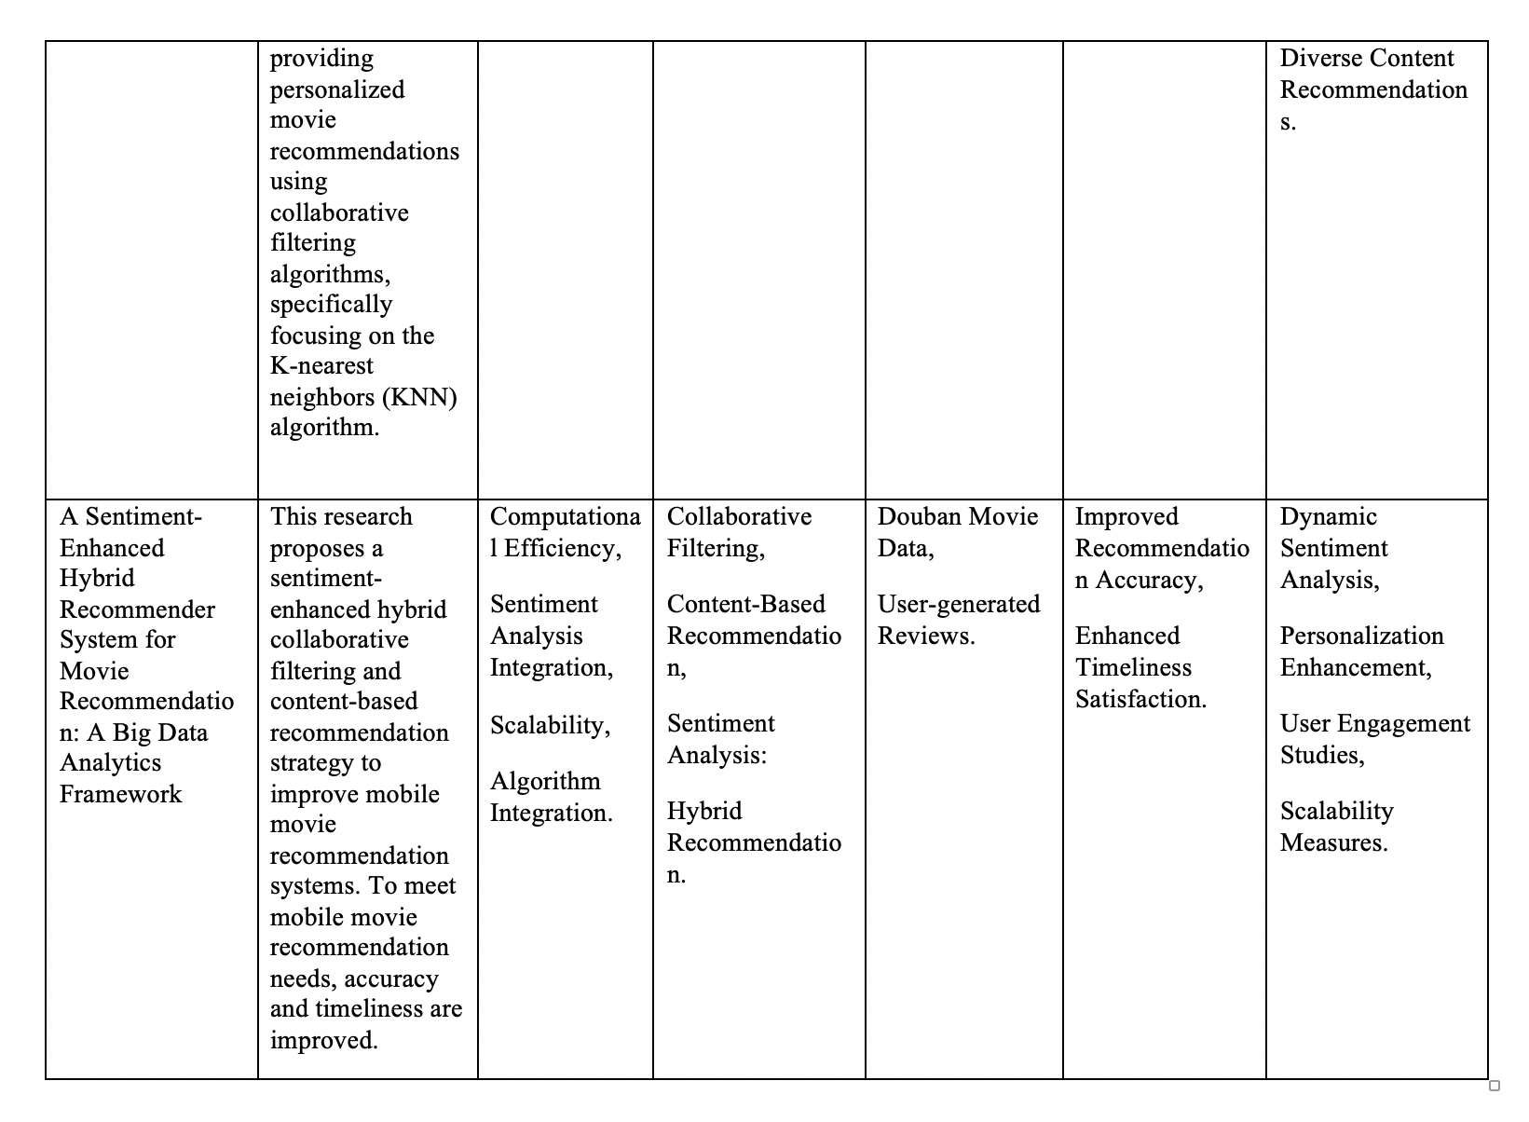
Literature Review

Slide 8


CHALLENGES
Deep Learning for Sentiment Analysis
Cold Start Problem
Privacy Concerns
Optimal Combination of Methods

Slide 9
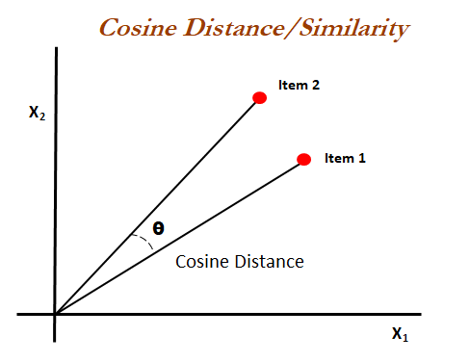
Proposed Solution
1) Content-Based Similarity Computation:
Cosine similarity is a metric used to measure how similar the documents are irrespective of their size.
The smaller the angle, higher the cosine similarity.

Slide 10
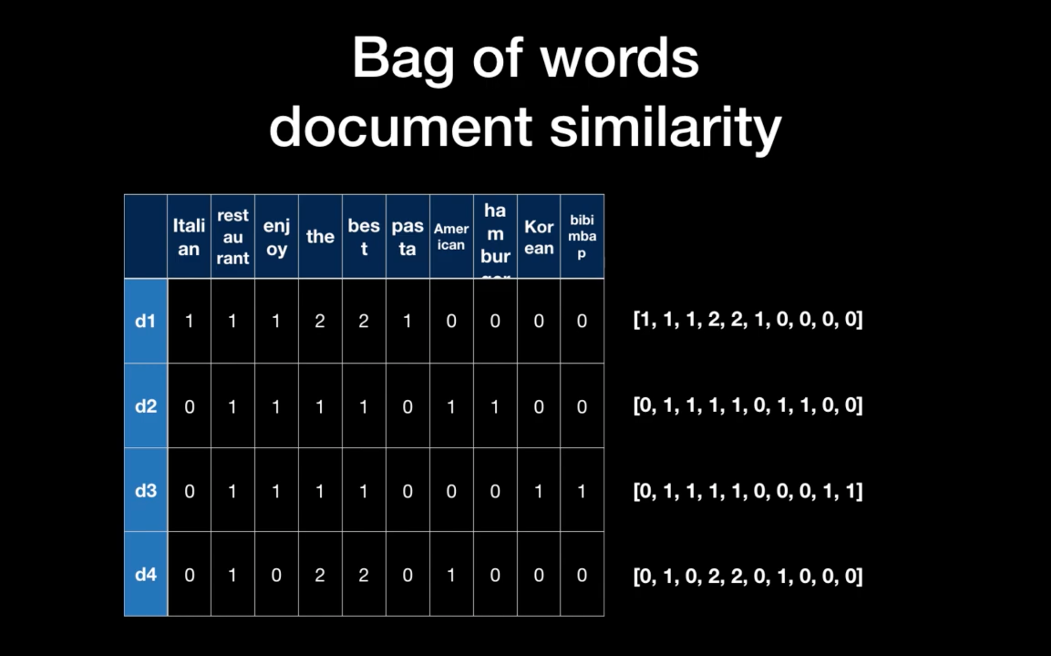
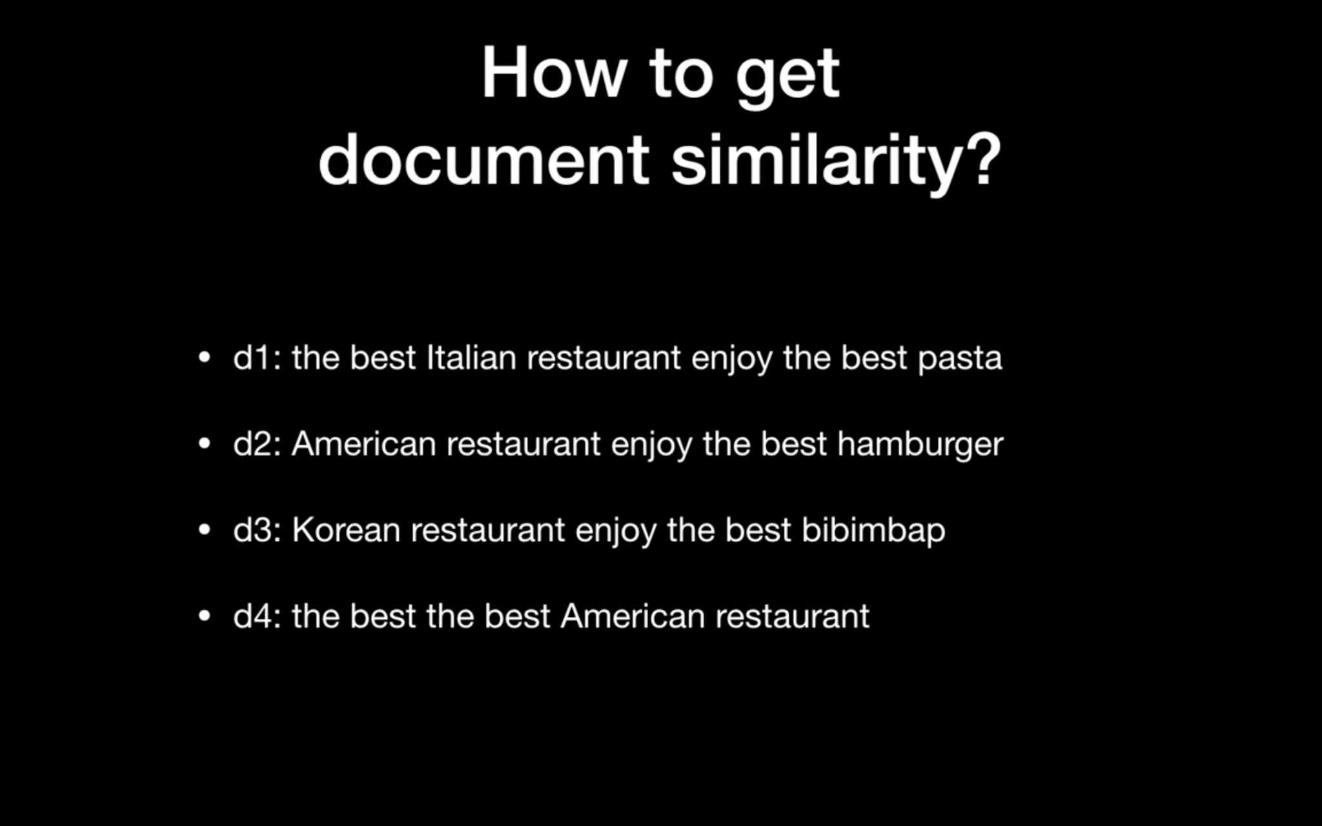

Slide 11
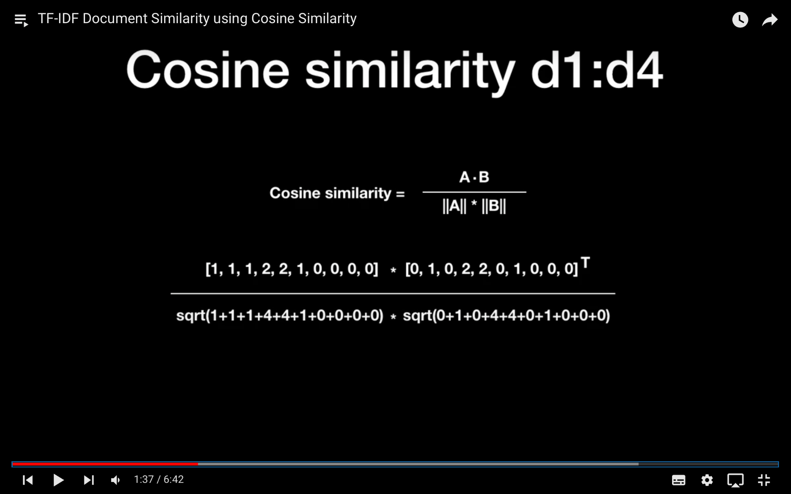
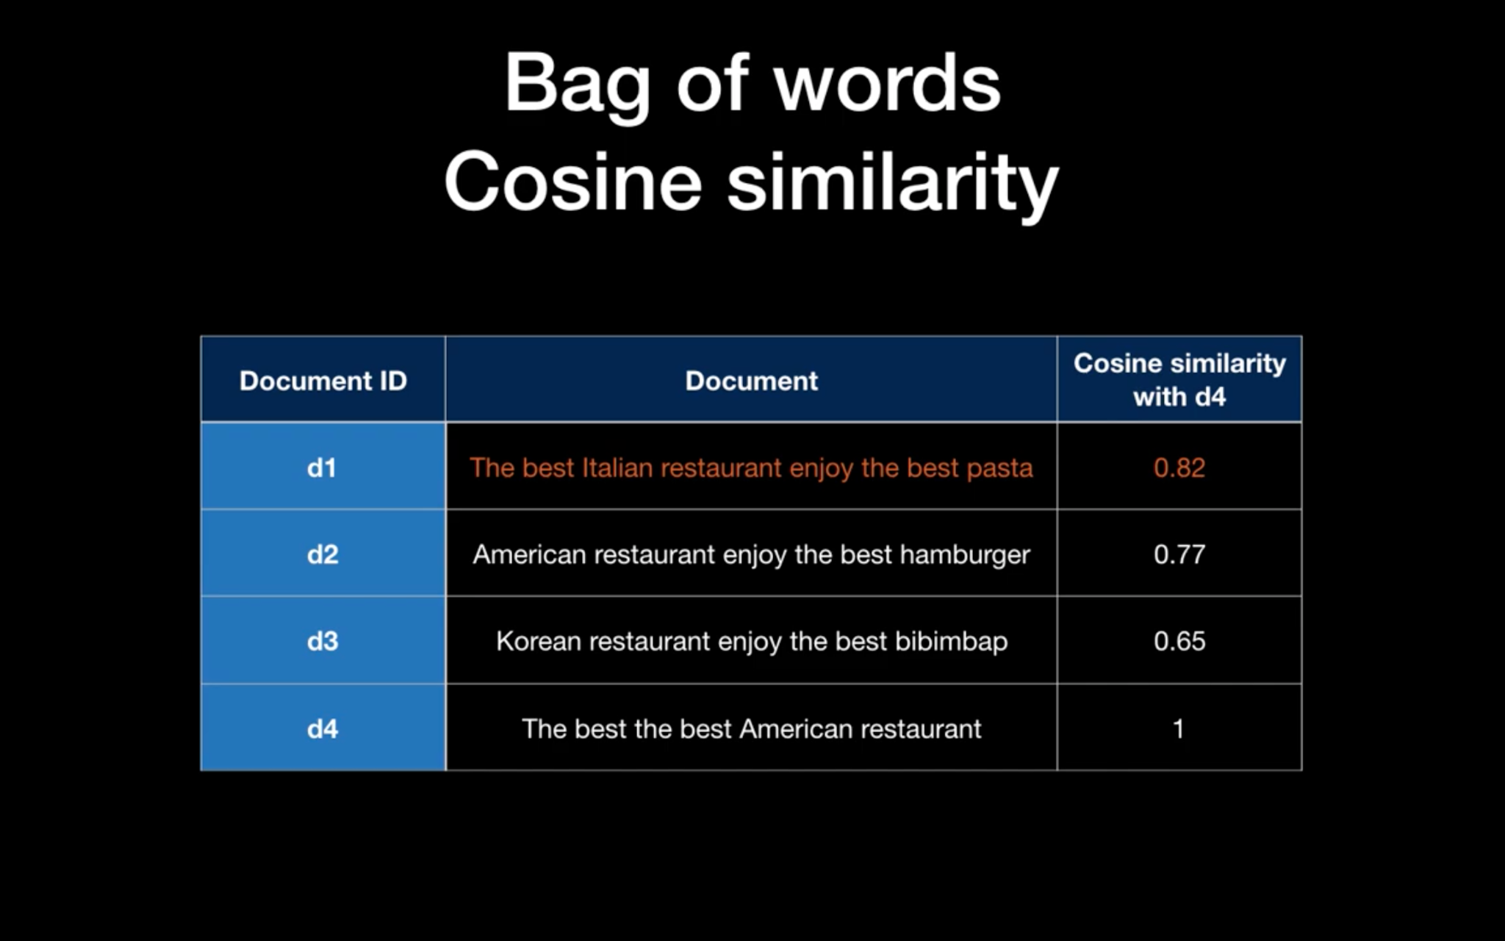

Slide 12
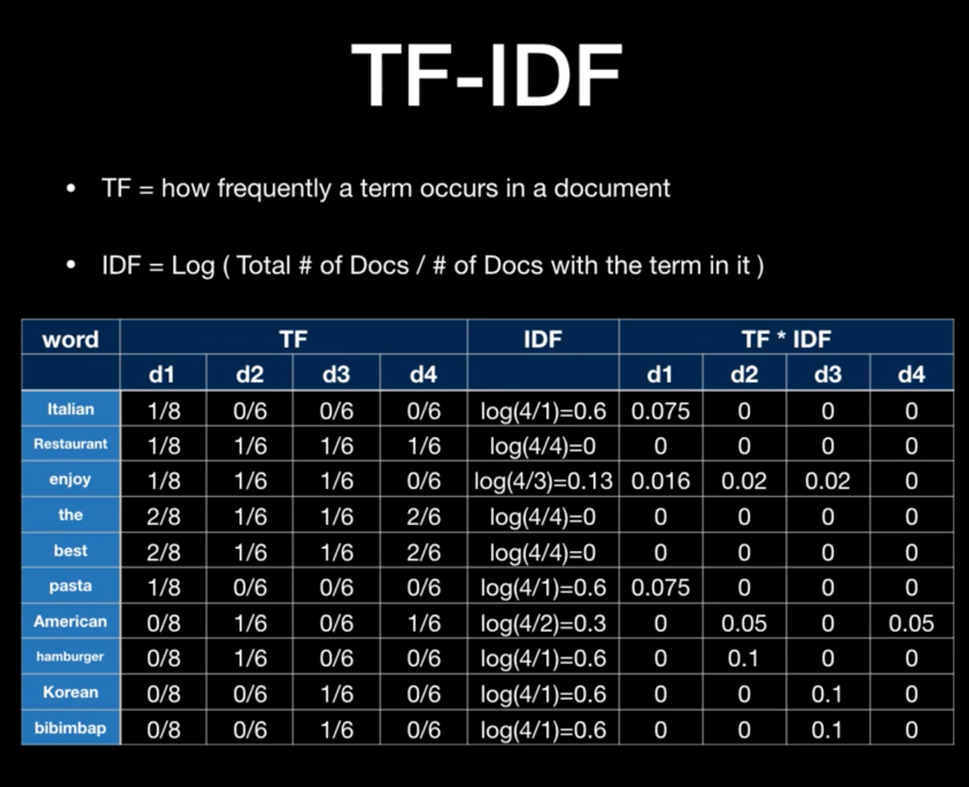

Slide 13
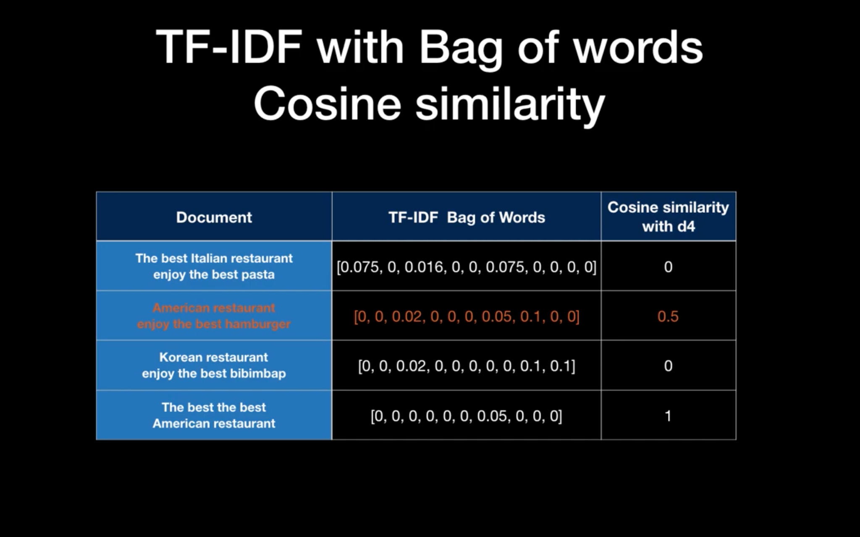

Slide 14
2) Sentiment Analysis:
Natural Language Processing (NLP): Apply NLP techniques to preprocess and analyze user reviews obtained from IMDb. Tokenization, stemming, and removal of stop words are essential steps in this process.
Naive Bayes
Integration with Recommendation System

Slide 15
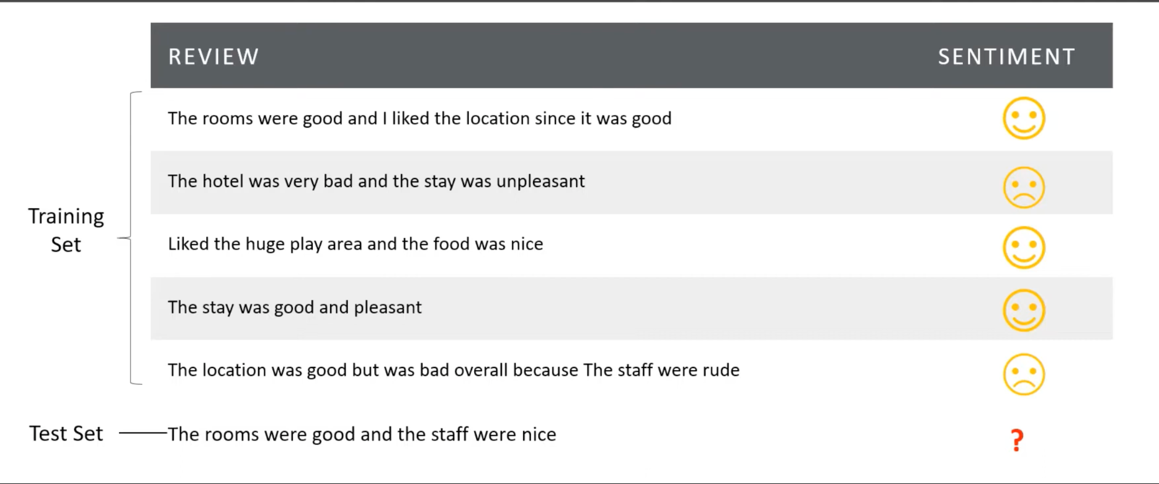

Slide 16
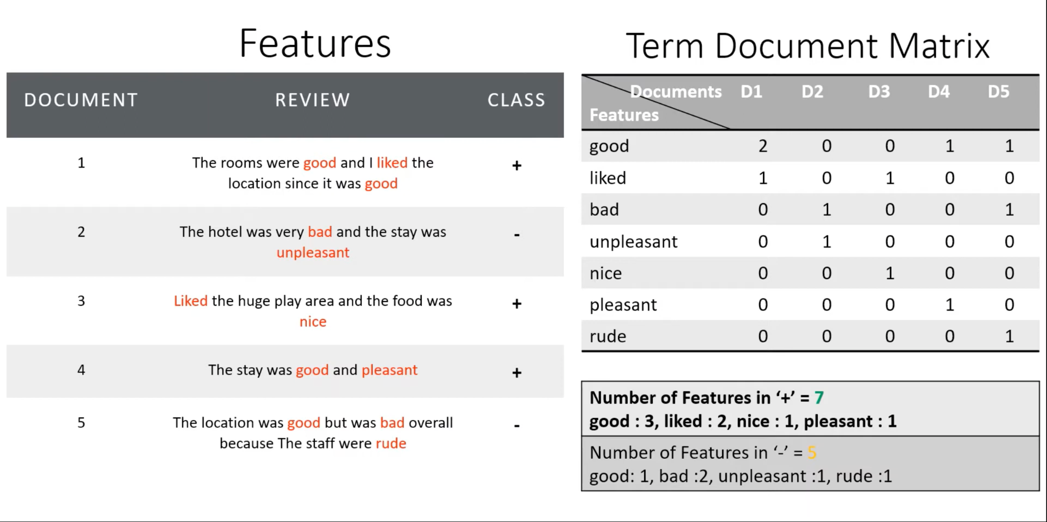

Slide 17
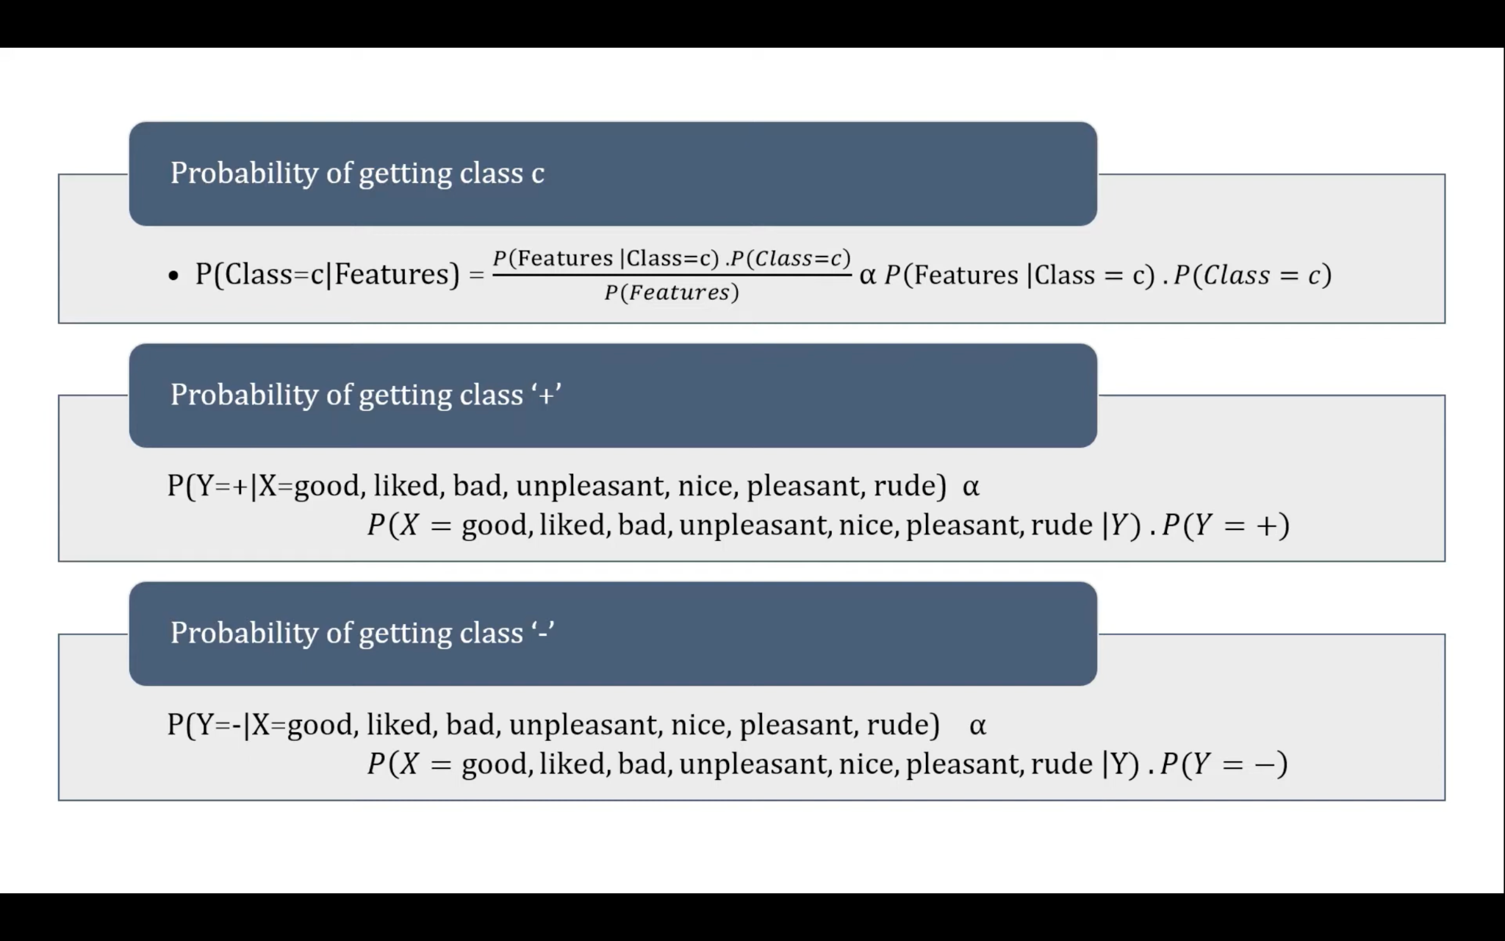
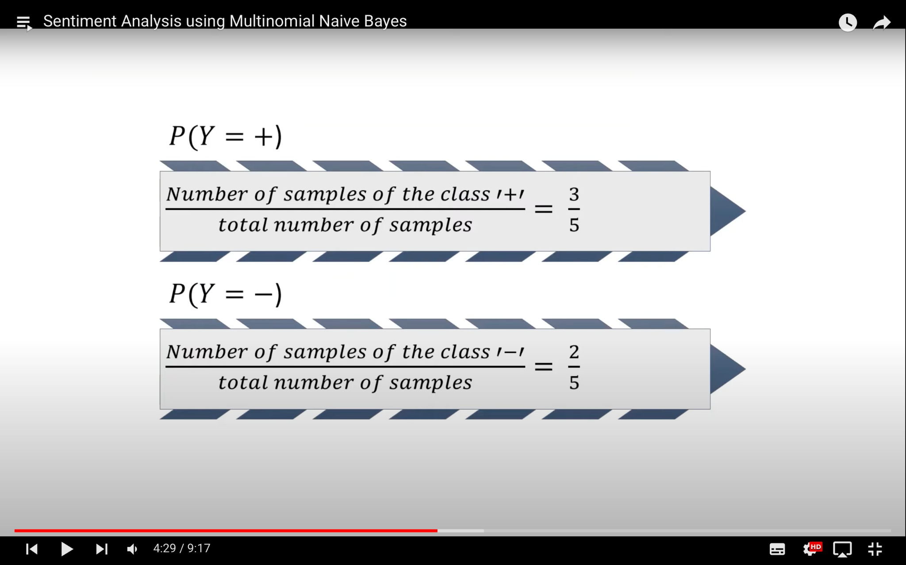

Slide 18
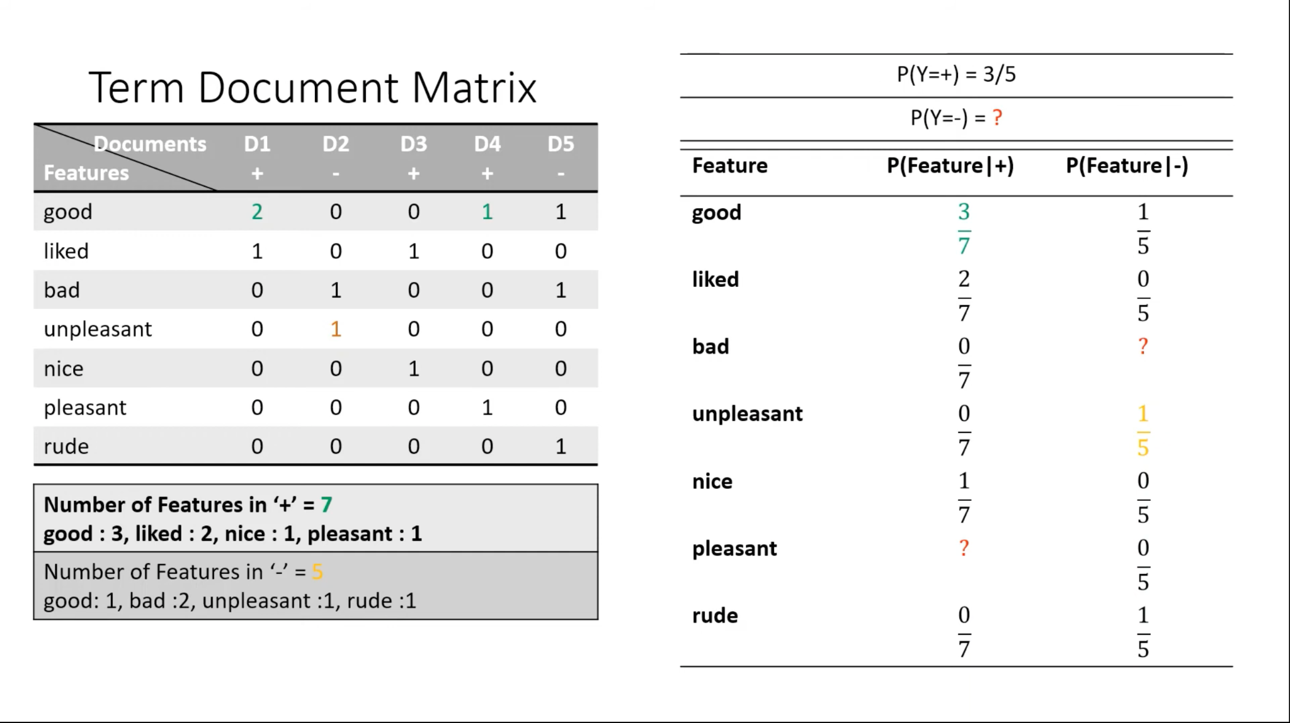

Slide 19
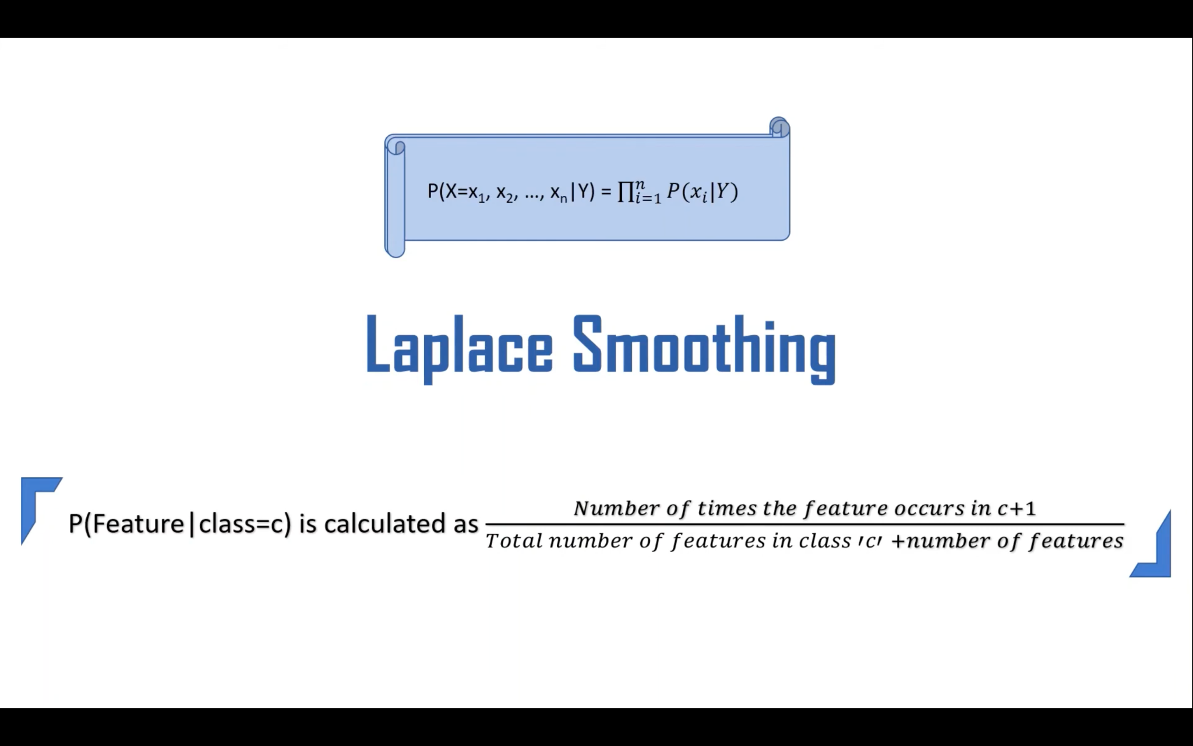
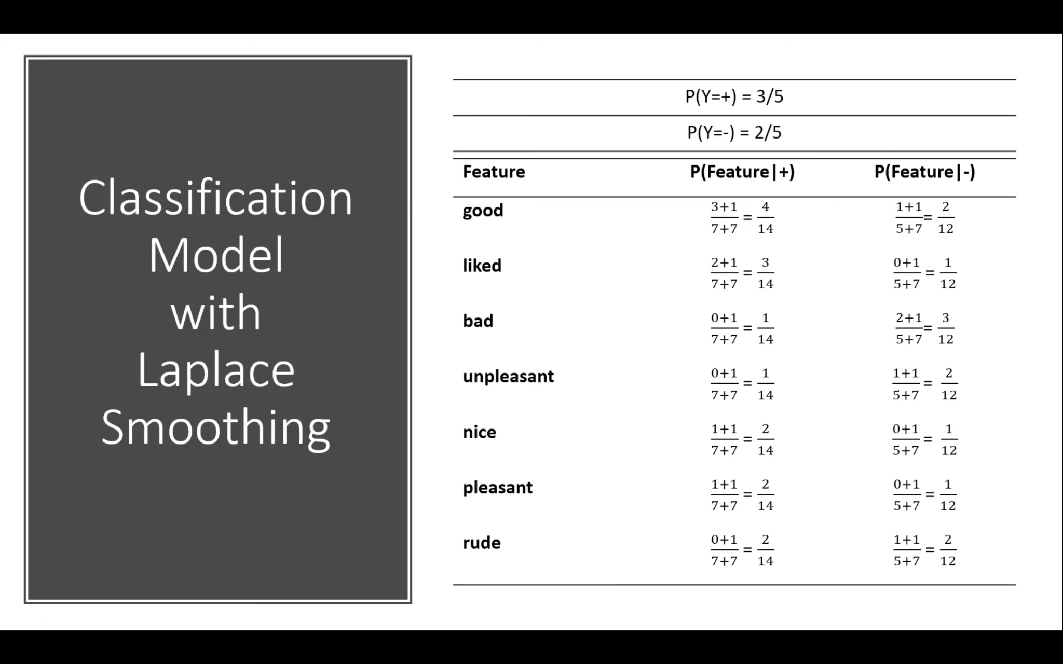
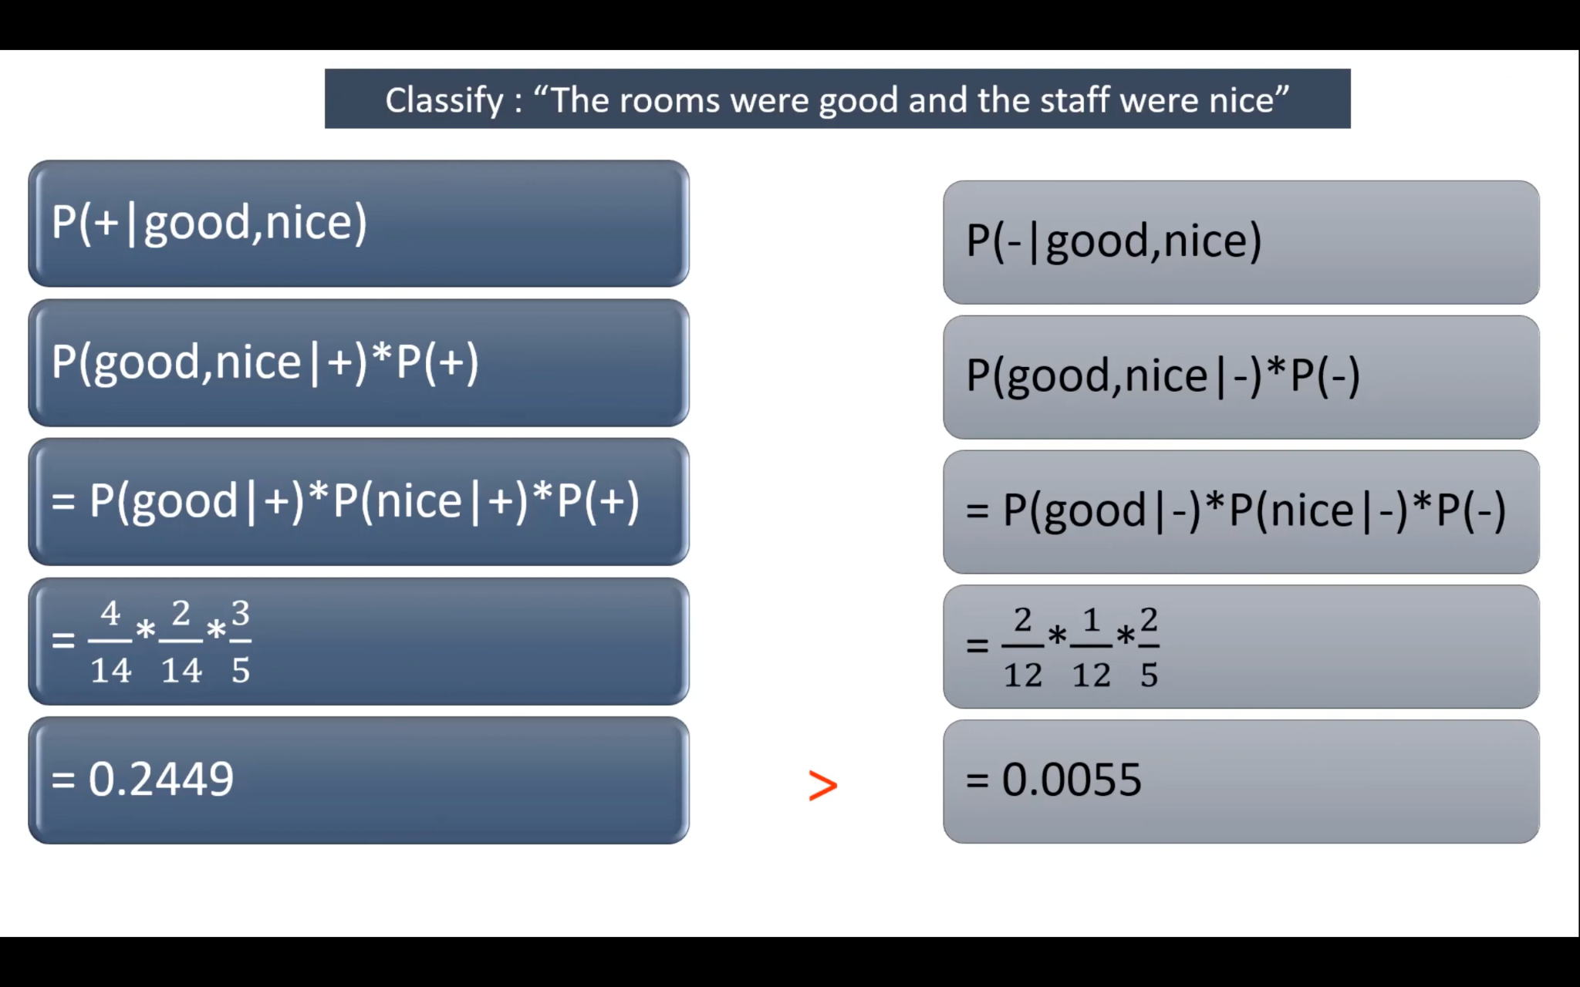
Laplace Smoothing
“The Rooms were good and the stuff were nice”

Slide 20
3) Data Acquisition:
TMDB API Integration: Utilize the TMDB API to fetch movie details such as title, genre, runtime, rating.
Web Scraping IMDb for Reviews: Use web scraping, specifically with BeautifulSoup4, to extract user reviews from IMDb using the IMDb ID obtained from TMDB.

Slide 21
DATASET
IMDb 5000 Movie Dataset
The Movies Dataset: The Movies Dataset is another comprehensive collection of movie data that includes information on a wide range of movies. It provides details such as movie titles, genres, release dates, and user ratings, contributing to the diversity and richness of the dataset for the project.
List of Movies in 2018, 2019, 2020.
Reviews dataset (7086 )
Final Processed Data of movies: 6010
Final Processed Data of reviews: 6918X2

Slide 22
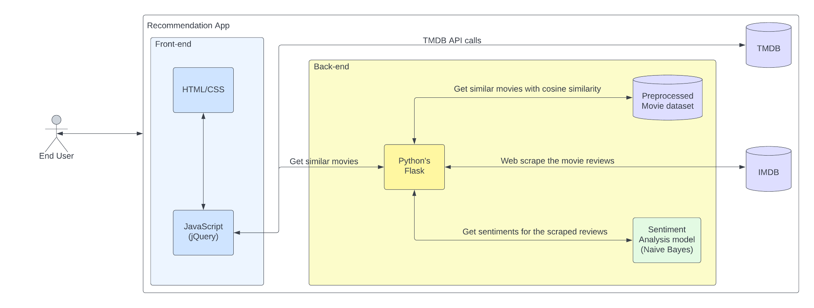
Architecture

Slide 23
Experimental Setup and Evaluation
Data Integration:
Combine data from the IMDb 5000 Movie Dataset and The Movies Dataset to create a comprehensive movie database with a wide range of features.
Content-Based Similarity Evaluation:
Feature Selection: Identify key features such as genre, runtime, and rating from the TMDB data for content-based similarity computation.
Cosine Similarity Calculation: Implement and evaluate cosine similarity for a subset of movies, measuring the similarity scores against known user preferences.
Sentiment Analysis Evaluation:
Preprocessing: Apply preprocessing steps including tokenization, stemming, and stop-word removal to prepare the user review dataset for sentiment analysis.
Train-Test Split: Split the sentiment-labeled dataset into training and testing sets for training and evaluating the sentiment analysis model.
Model Training: Utilize machine learning or deep learning models for sentiment analysis, training on the labeled dataset to predict sentiments.

Slide 24
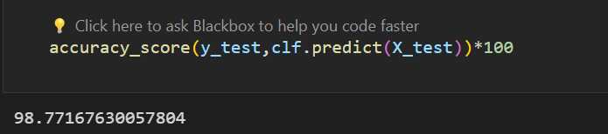
RESULT

Slide 25
CONCLUSION
In conclusion, the Content-Based Movie Recommender System with Sentiment Analysis provides a promising approach to enhance user experience in the real of movie recommendations.

Slide 26
FUTURE WORK
Scalability and Efficiency
01
02
User Feedback Integration
03
Privacy-Preserving Techniques
Enhanced Sentiment Analysis
04

Slide 27
REFERENCES
[1] https://ieeexplore.ieee.org/abstract/document/9103168
[2] A Sentiment-Enhanced Hybrid Recommender System for Movie Recommendation: A Big Data Analytics Framework
[3] https://ieeexplore.ieee.org/abstract/document/9388340
[4] An intelligent movie recommendation system through group-level sentiment analysis in microblogs -ScienceDirect

Slide 28





DEMO

Slide 29
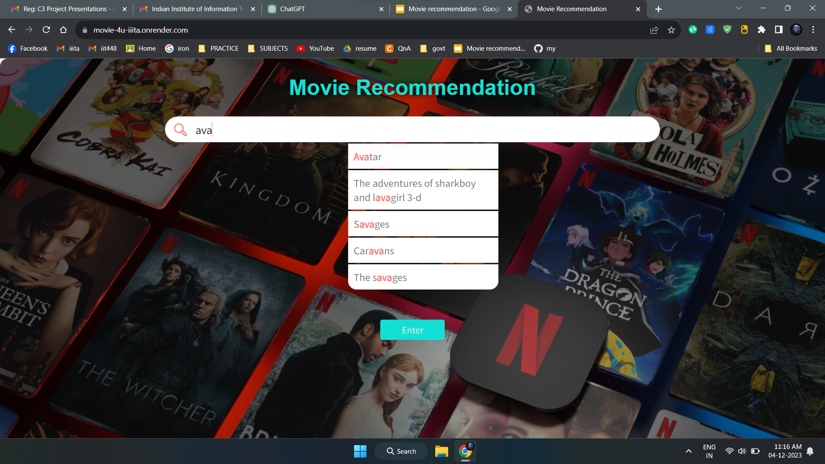
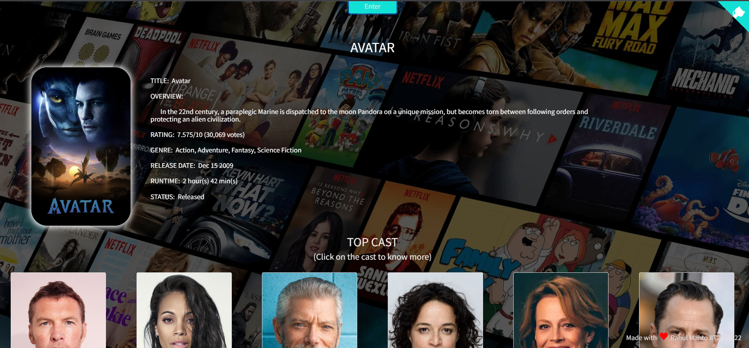
Search Suggestions

Slide 30
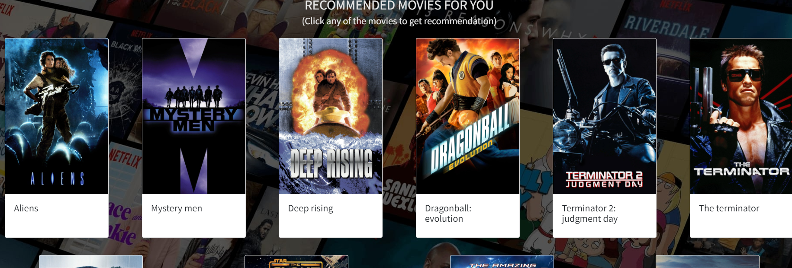
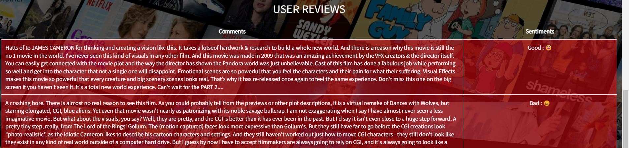
Recommendation Movies

Slide 31

THANK YOU!

